Slide 1
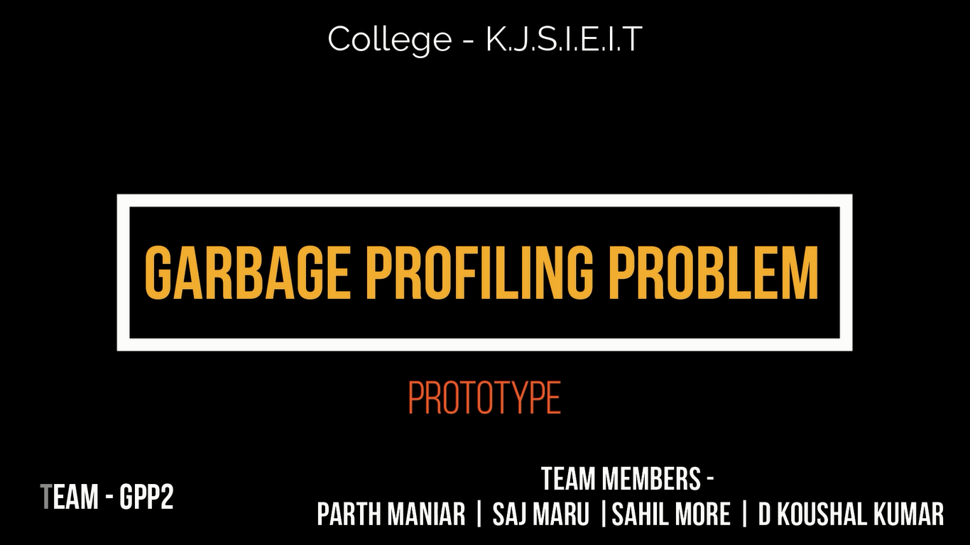
K . J . S. I. E. I. T
K. J. Somaiya Institute Of Engineering And Information Technology, Sion, Mumbai
Parth Maniar
Saj Maru
Sahil More
D Koushal Kumar
.
TEAM - GPP2

Slide 2
Problem We Are Solving
The problems related to waste management
How can government monitor the rightful practise of waste segregation by the societies
Educating common people about how to segregate waste
Detecting and alerting about the wrongful disposal of hazardous waste.
Maintaining hygiene in public toilets

Slide 3



Slide 4






Our Solution
Our Solution
Web-App
Android App
iOS App
Artificial Intelligence
Machine Learning
IoT

Slide 5
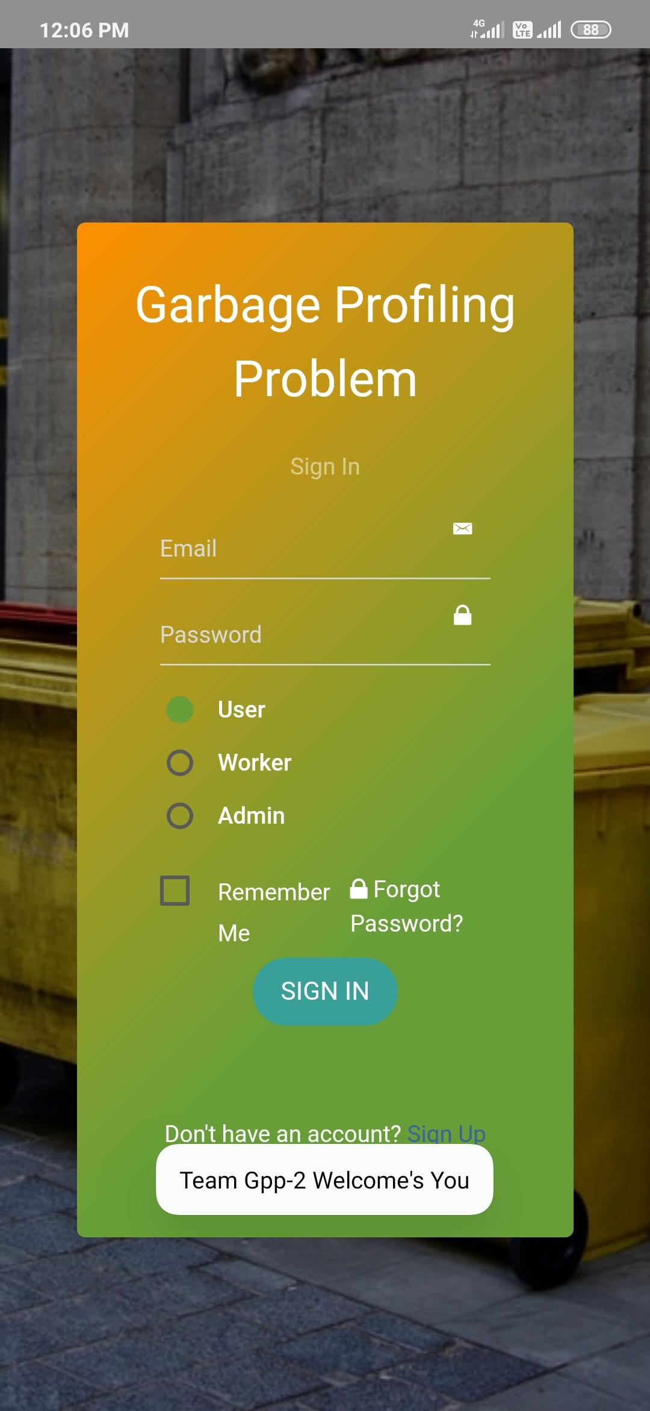
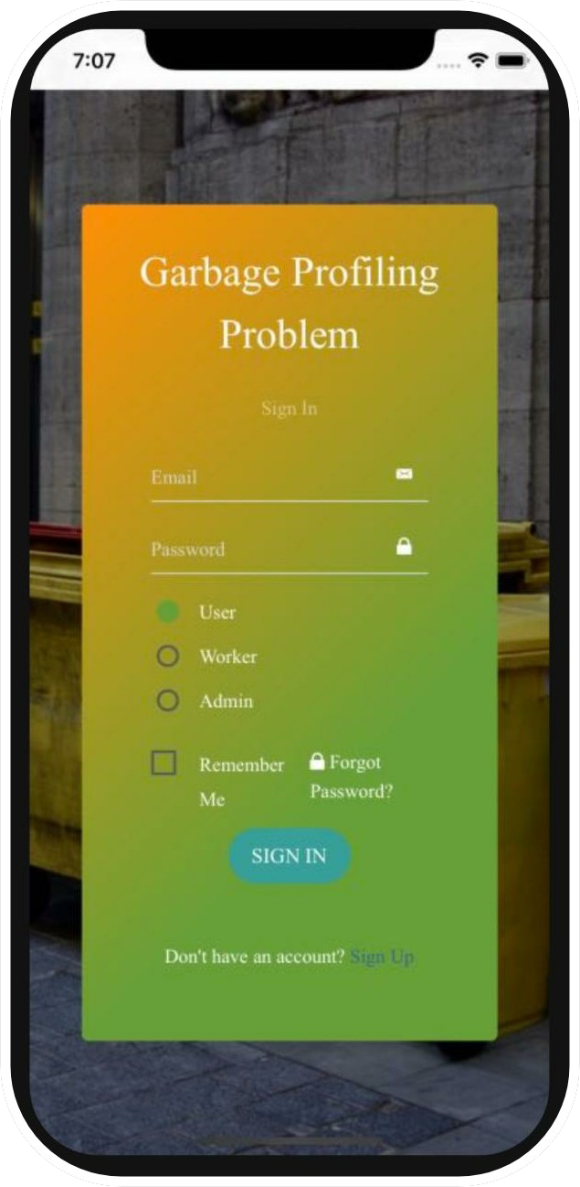
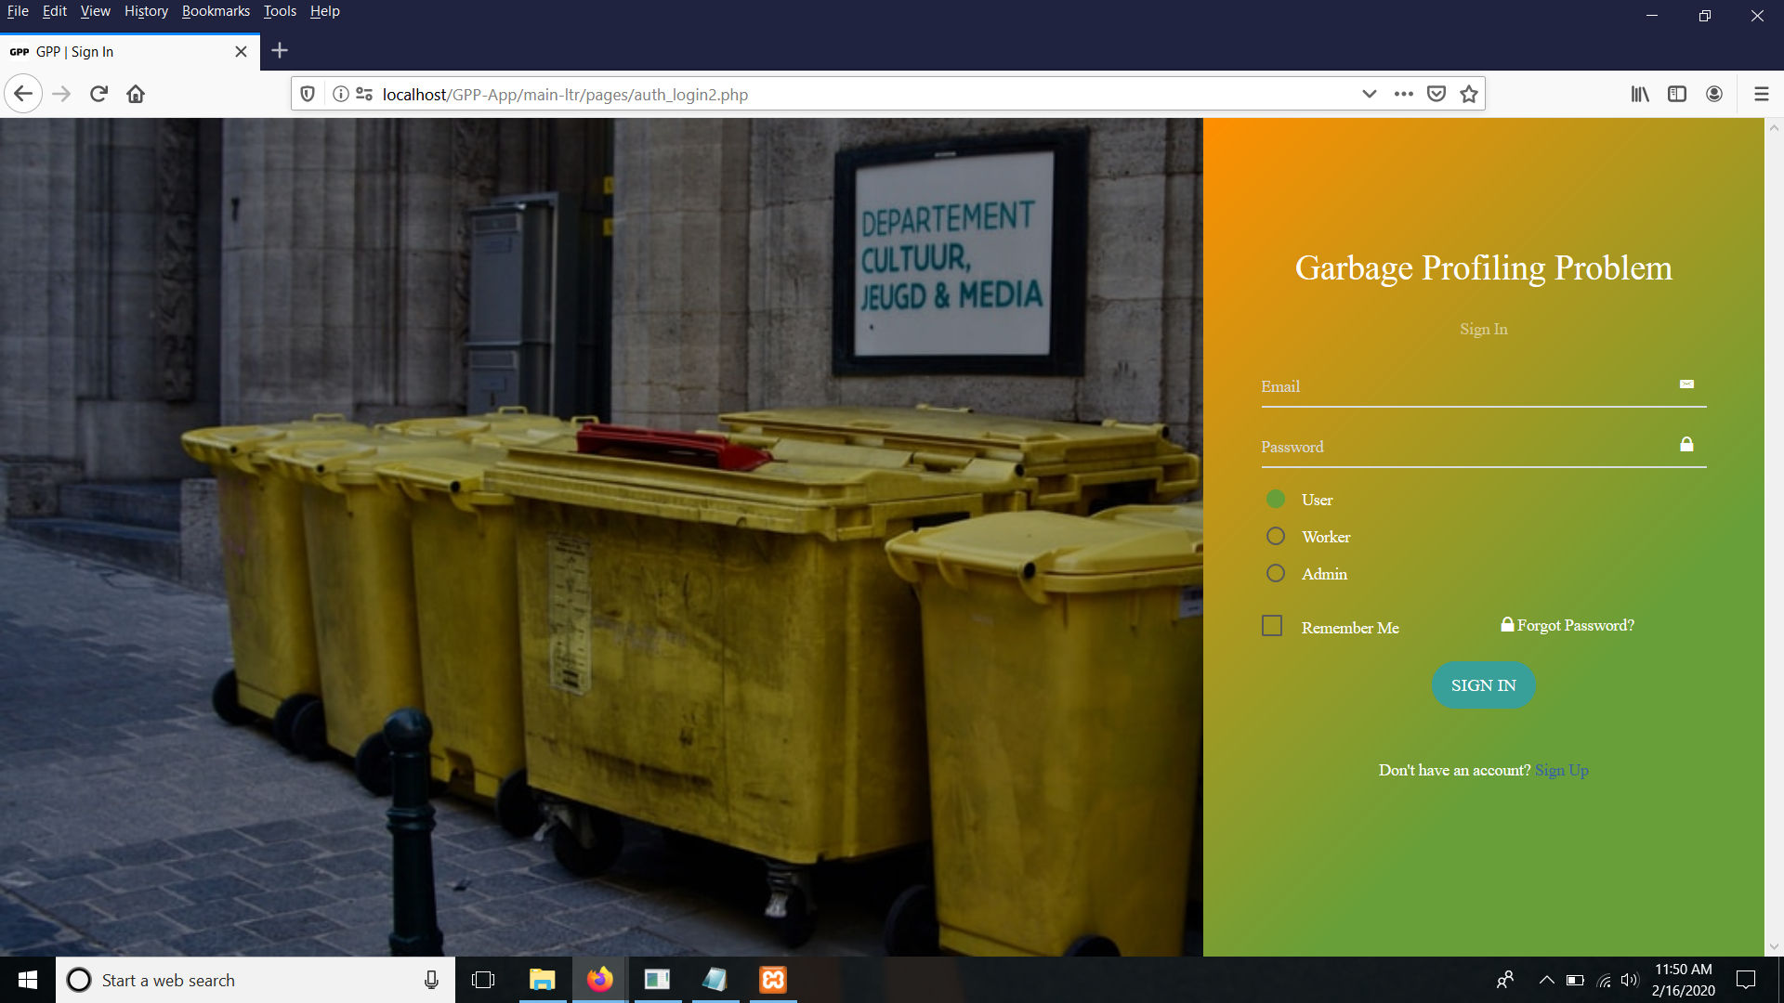
Android
iOS
Web App

Slide 6
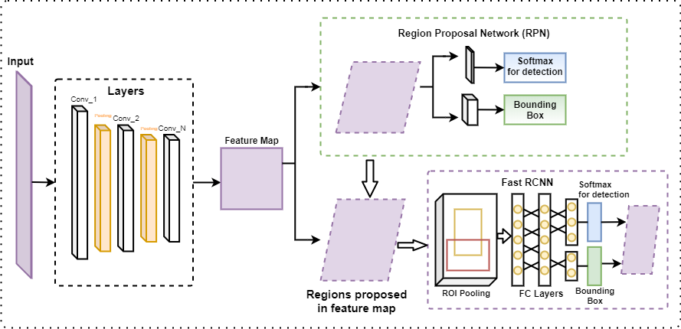

Slide 7
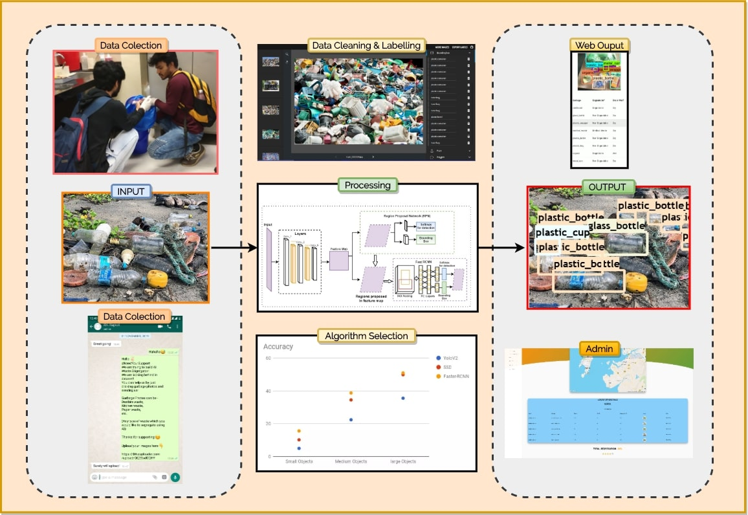

Slide 8
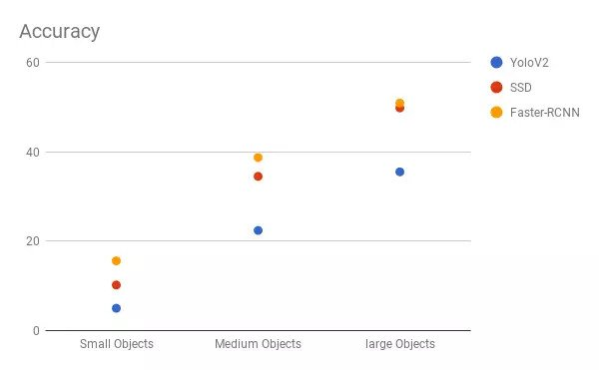
100
50
25

Slide 9
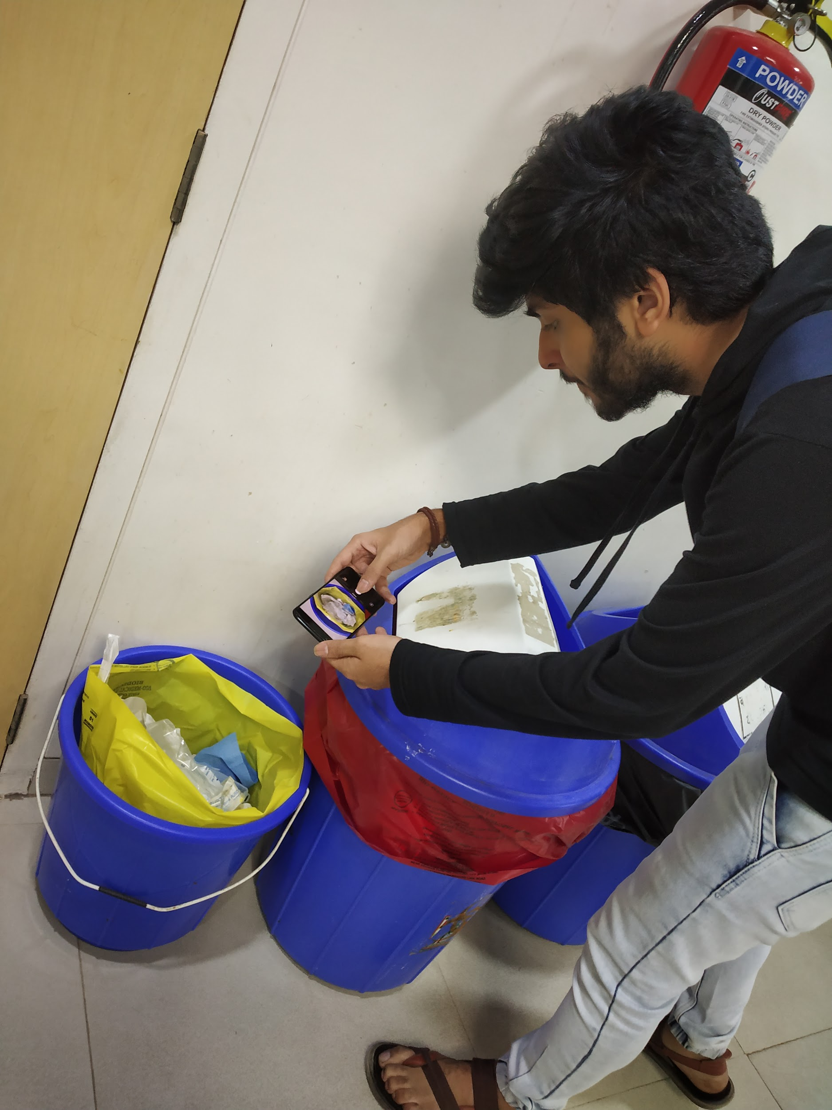
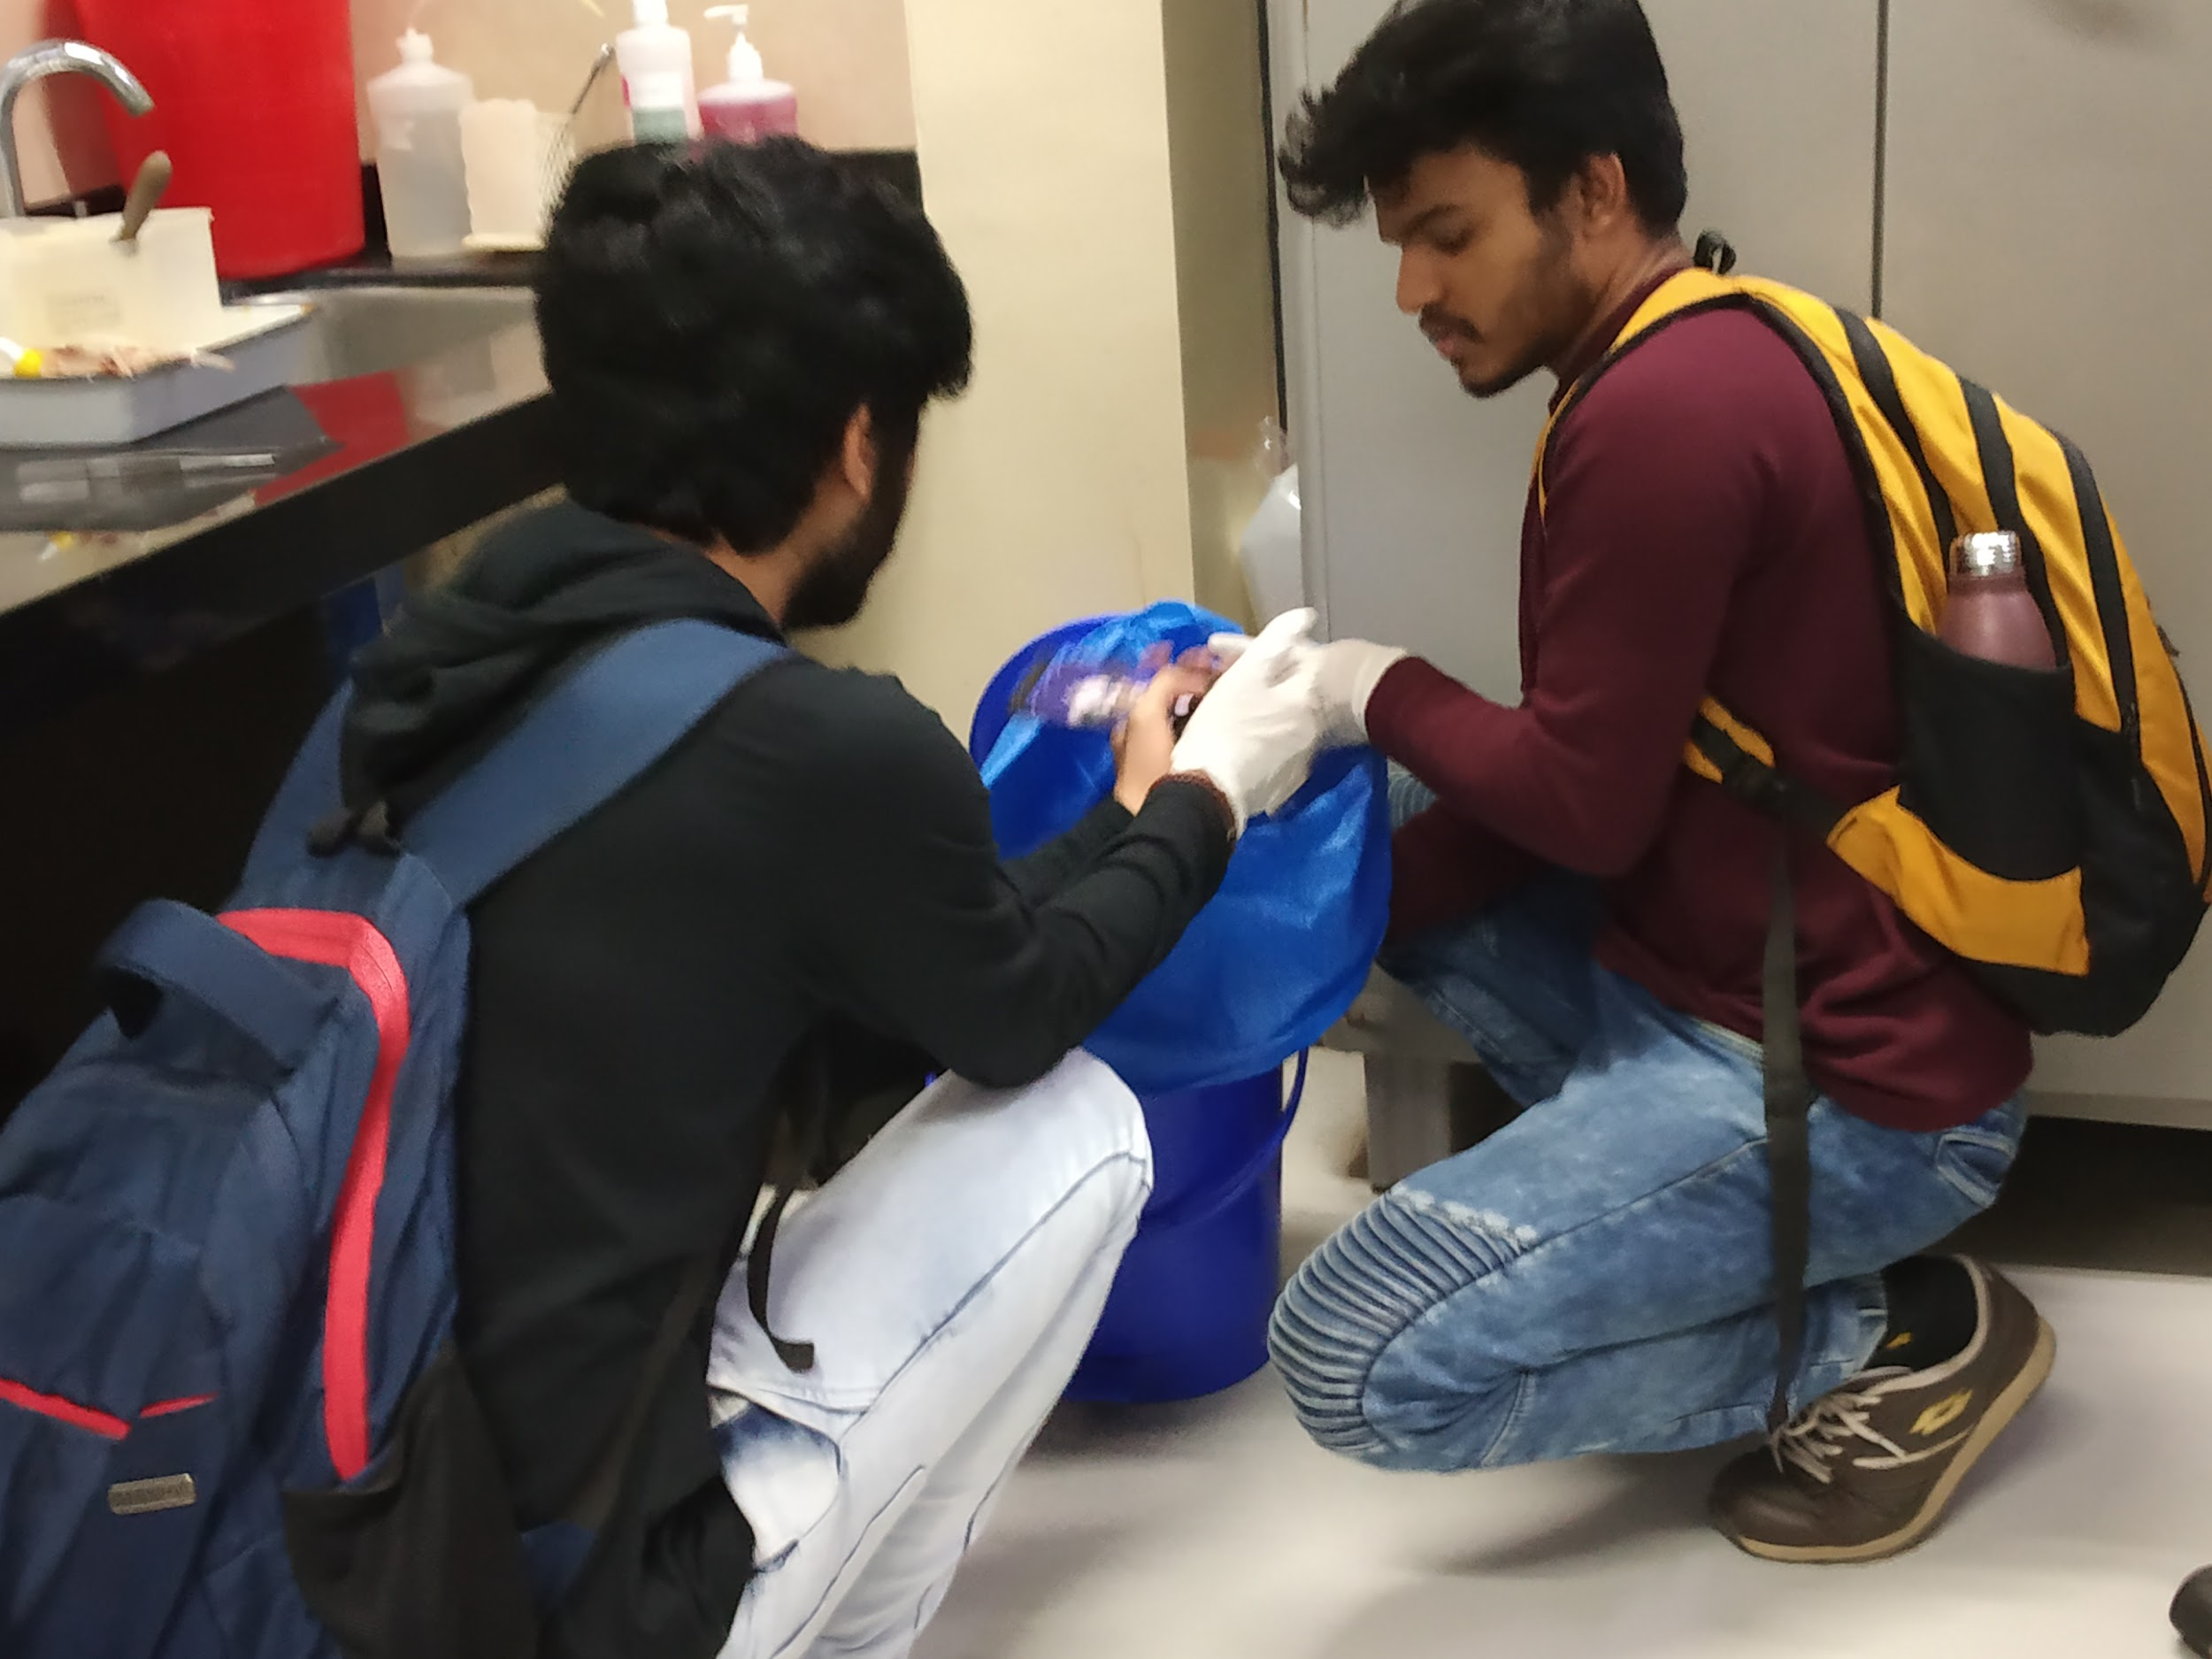
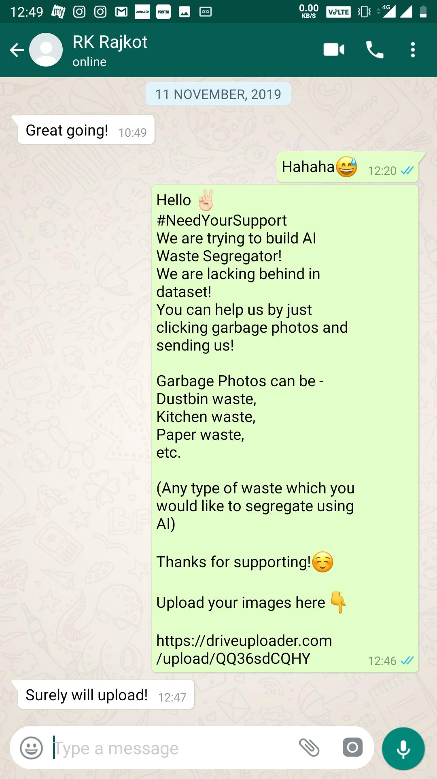
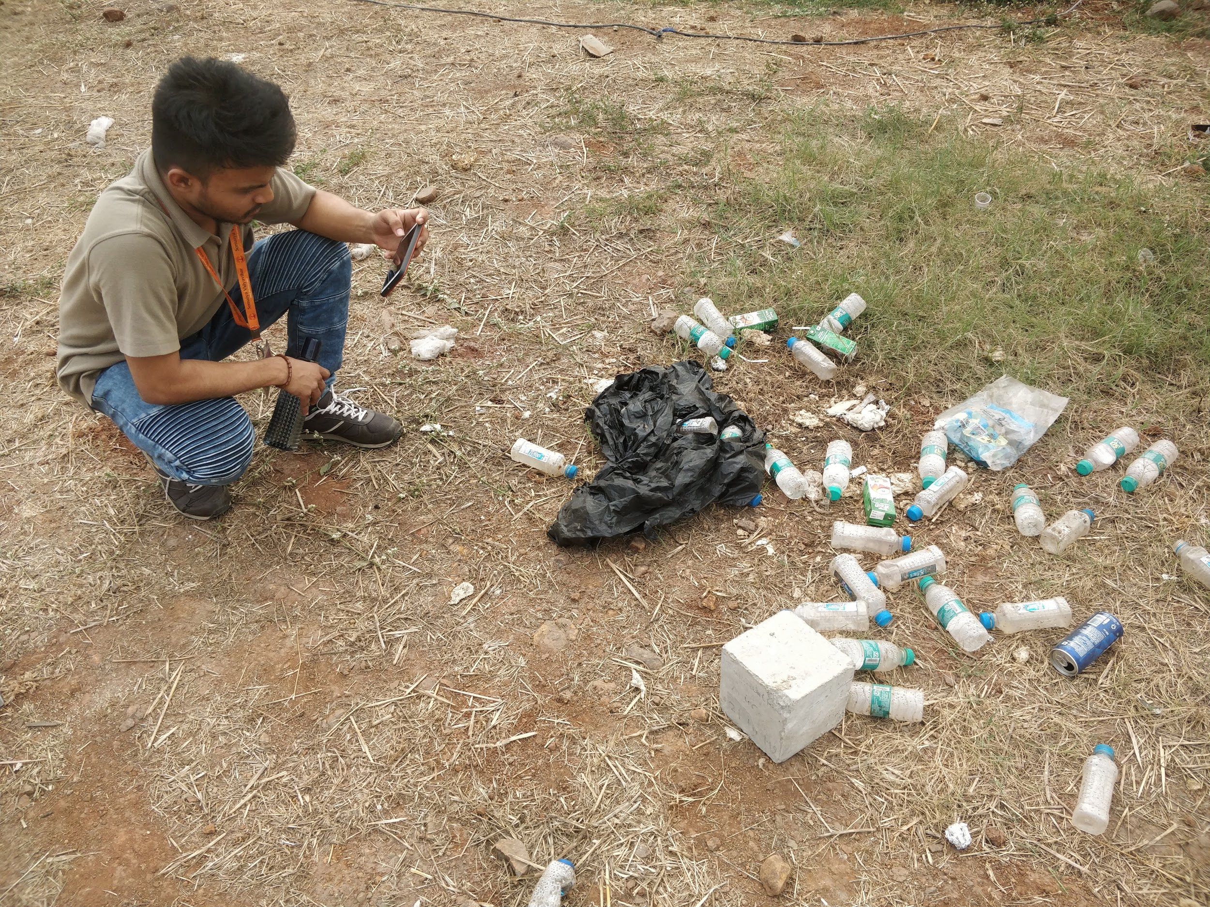
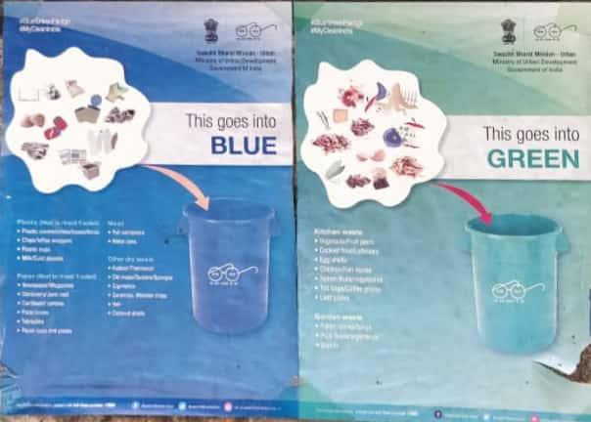
Data Collection

Slide 10
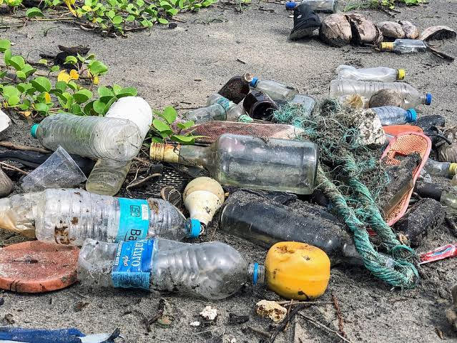
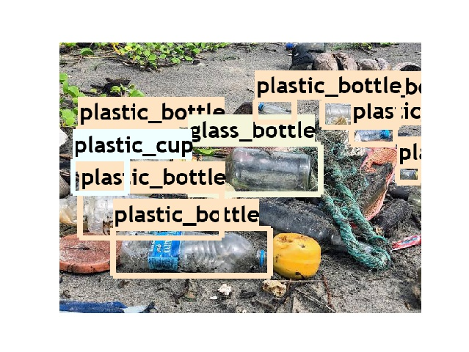
Input
&
Output

Slide 11
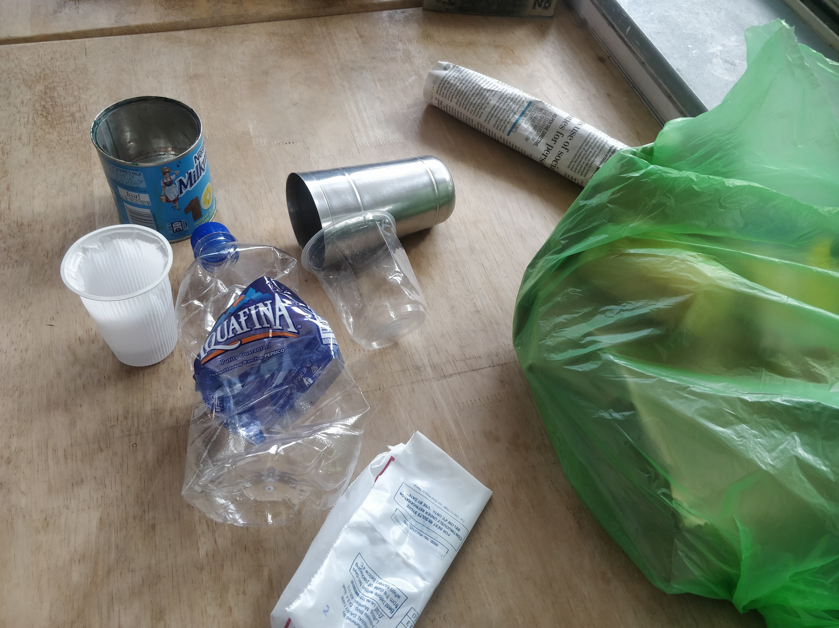
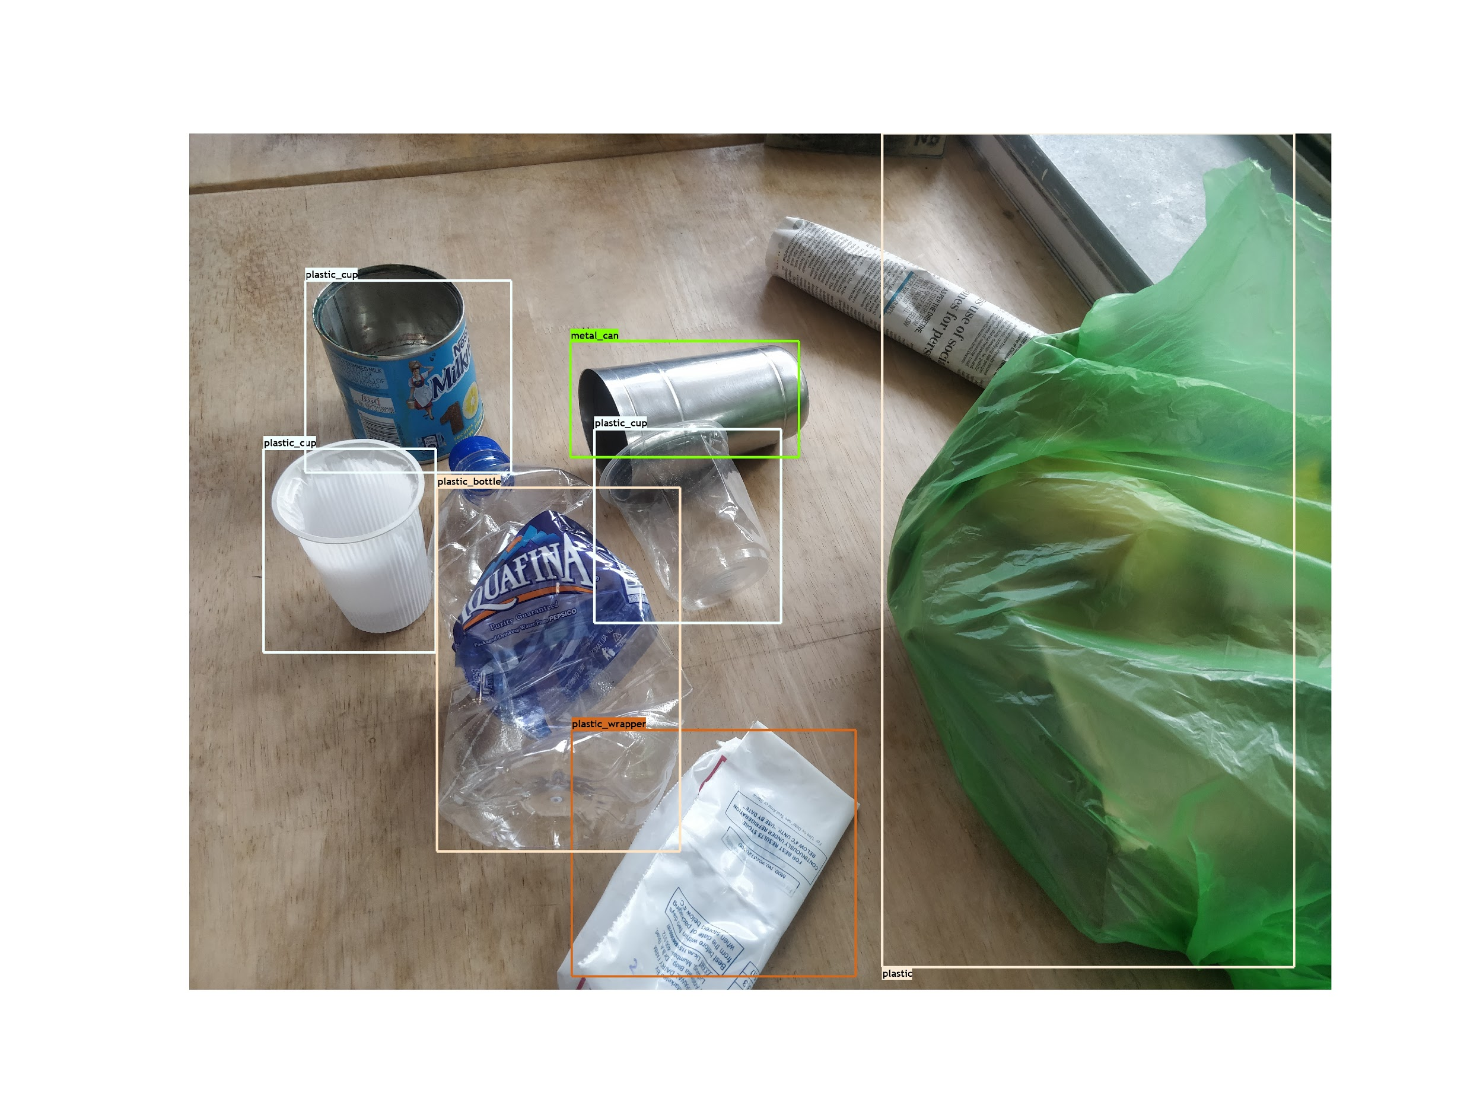
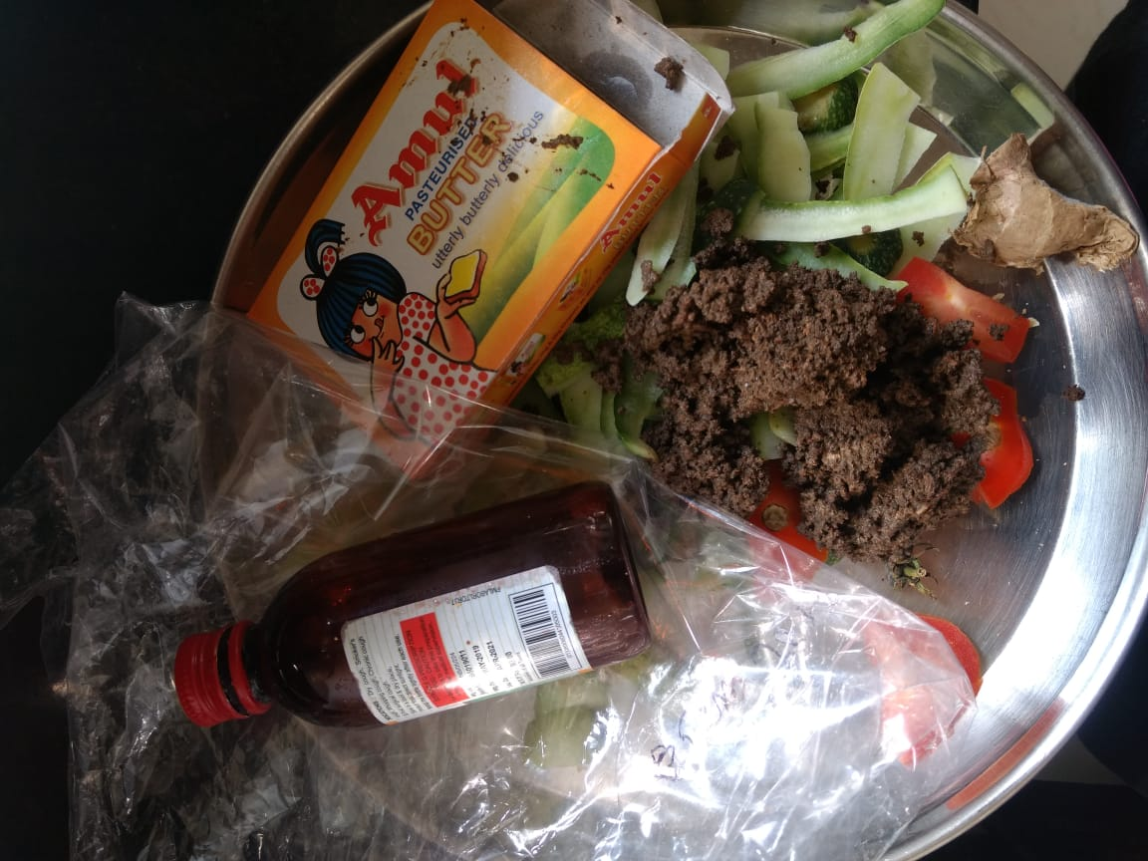
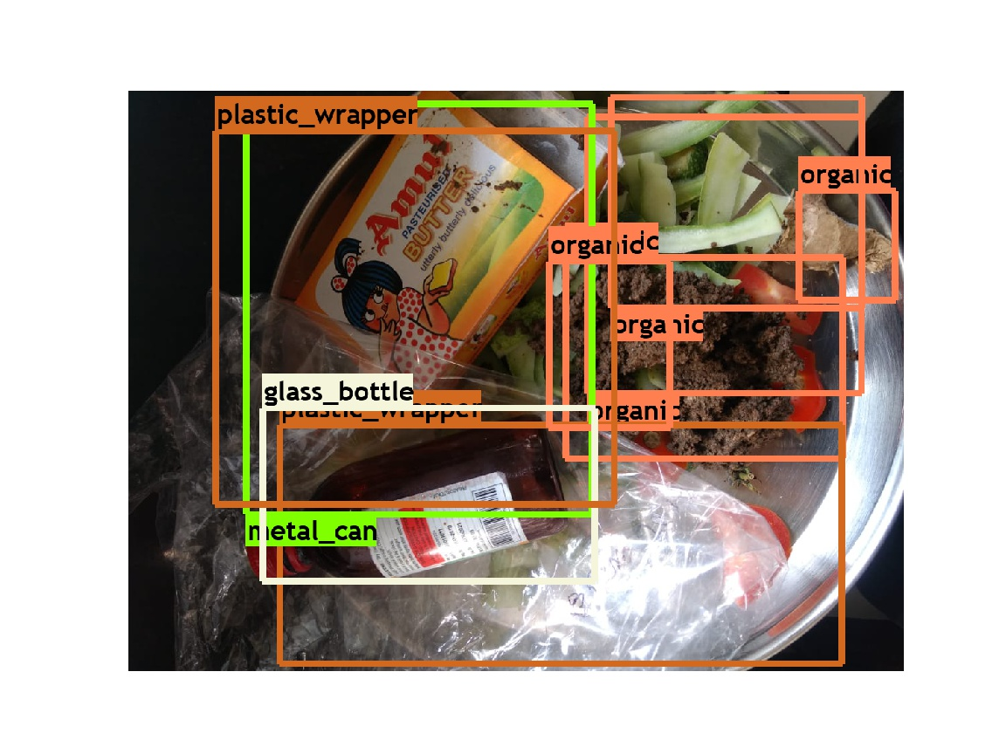
Input
Results
Input
Results

Slide 12
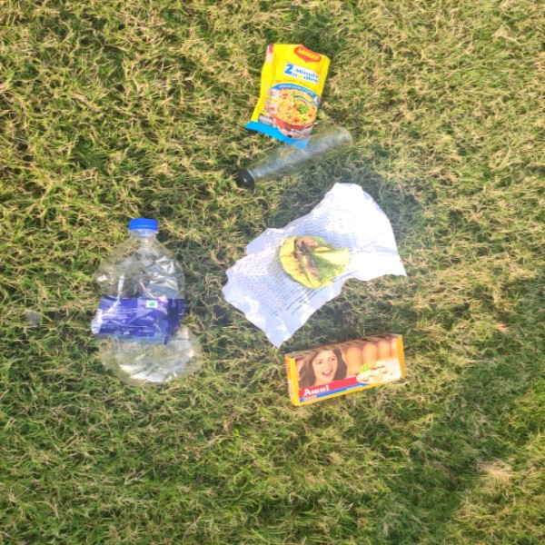
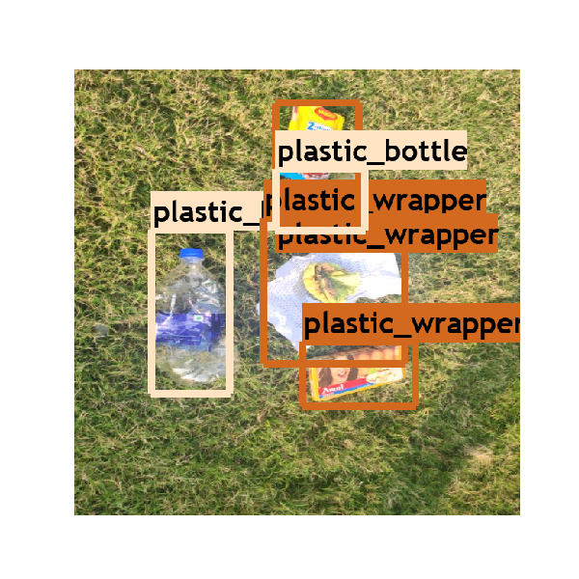
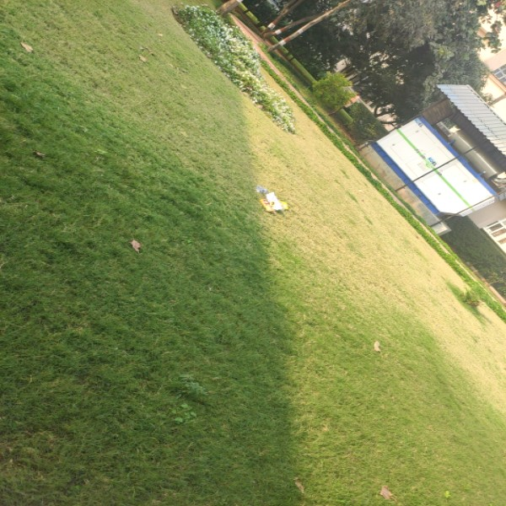
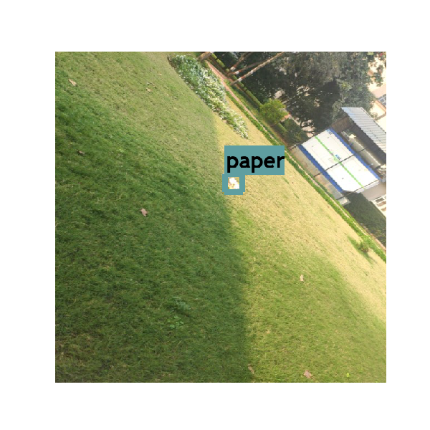
Input
Results
Input
Results

Slide 13
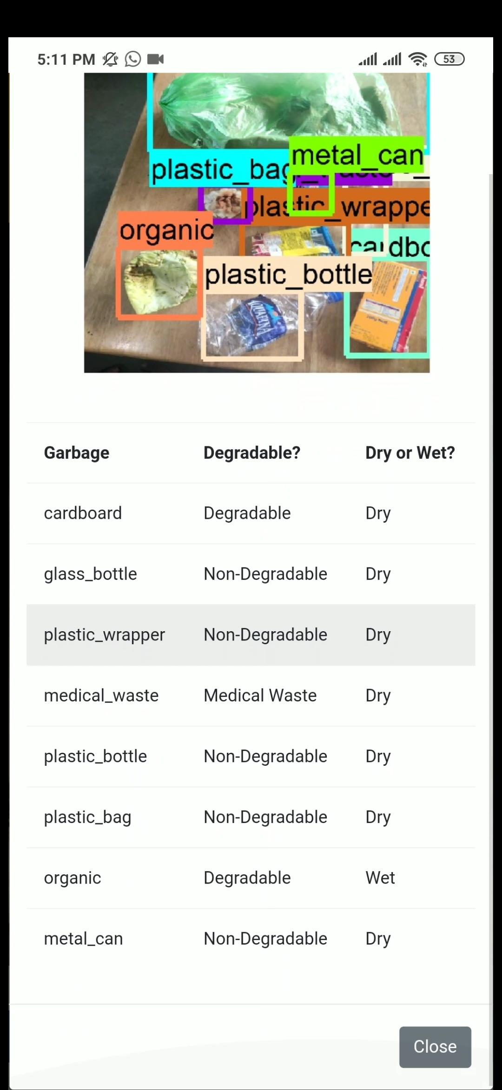
User
AI - Cam Output

Slide 14
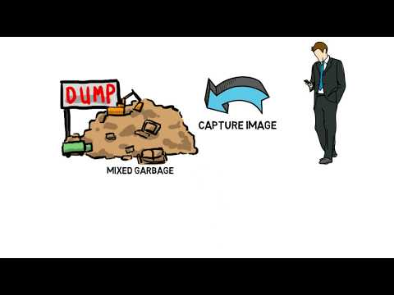
Working Prototype

Slide 15

Underlying Magic
Provide a gamified experience to the users by providing coins on every click of image to segregate waste, these coins can be used to redeem varios discount coupons and vouchers.

Slide 16

Our Profits
Our main stream of revenue would be the profits earned by sponsors.
Maintenance and servicing.
Advertisements on our app & website.
Providing a premium version of our app with few special features.

Slide 17
Our Plan
Designing
Production
Marketing
Sponsors,Branding
Designing of the product right from scratch
Take the design to production mode. Select the best version and start manufacturing
Start marketing, attract and awaken more user and tie up with governing bodies
Get sponsors for the vouchers in the application. And branding the product

Slide 18
Thank You

